Slide 1
Introduction to Data Science
Lecture - 1
Sumita Narang

Slide 2
Objectives
Fundamentals of Data Science
Real World applications
Data Science vs BI
Data Science vs Statistics
Roles and responsibilities of a Data Scientist
Software Engineering for Data Science
Data Scientists Toolbox
Data Science Challenges

Slide 3


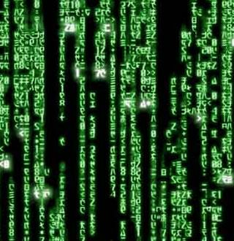
What is Data?
•
Data are raw facts and figures
that on their own have no
meaning
•
These
can
be
any
alphanumeric
characters
i.e.
text, numbers, symbols
Note the “are” bit above? Why?
The Latin word data is the plural of datum, "(thing) given," neuter past
participle of dare "to give". Data may be used as a plural noun in this sense,
with
some
writers—usually
scientific
writers—in
the
20th
century
using datum in the singular and data for plural.
4
BITS Pilani, Pilani Campus

Slide 4
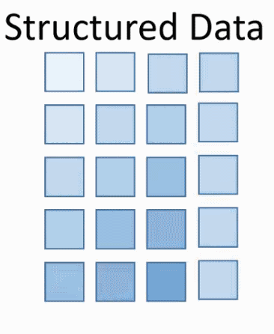
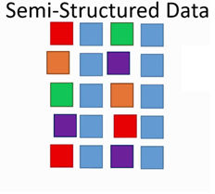
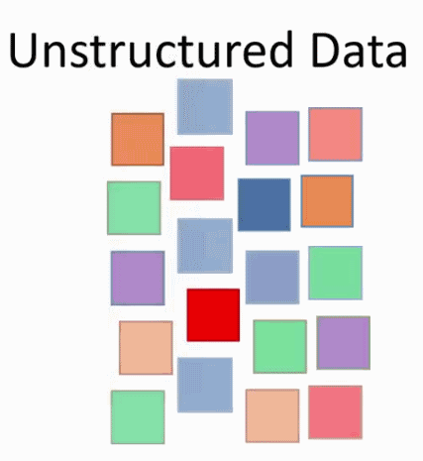
Types of Data
Traditionally, the data that we had was mostly structured and
small in size, which could be analyzed by using the simple BI
tools.
Unlike
data in
the
traditional
systems
which
was
mostly
structured, today most of the data is unstructured or semi-
structured.
5
BITS Pilani, Pilani Campus

Slide 5
Information Ladder
The information ladder was created by education professor
Norman Longworth to describe the stages in human learning.
According to the ladder, a learner moves through the following
progression to construct “wisdom”from “data”.
Data →
Information →
Knowledge →
Understanding →
Insight →
Wisdom
6
BITS Pilani, Pilani Campus

Slide 6
Data Science : Definition
Data science refers to areas of work concerned with various fields related to large collection of data –
Data Acquisition / Collection
Data Management, preservation and archival
Data Preparation
Data Modelling
Data Analytics & Visualization
Data Science
Data Acquisition
Data Preparation
Data Analysis /Visualization
Data Management / Storage
Data Modelling
Artificial Intelligence
Prerequisite for AI

Slide 7
Evolution of Data Storage & Processing
EDP Era
Cloud Era
Key Factors leading to transition of EDP to Cloud Era
Electronic Data Processing
Expensive storage on local physical servers
Local storage of data; Limited access to data
Low processing power
Cloud Data Processing
Cloud storage of data; free/easy access to data
Cheap storage on Cloud
Extensive Cloud (GPUs) processing power
NFV
Network Function Virtualization (routing, load balancing, firewalls packaged on virtual machines (VMs) – leads to statistically multiplexing of HW resource
Reduced Cost considerably, better utilization of HW
SDN
Software Defined Networking
The physical separation of the network control plane from the forwarding plane, and where a control plane controls several devices.
IoT
Internet of Things
Each device connected to internet, collecting data, transferring data to Central Cloud based storage
Abundance of data, easily accessible data
Proprietary Control plane separated from generic forwarding plane – eliminates need of specialized HW -> further cost reduction
Details
Details

Slide 8
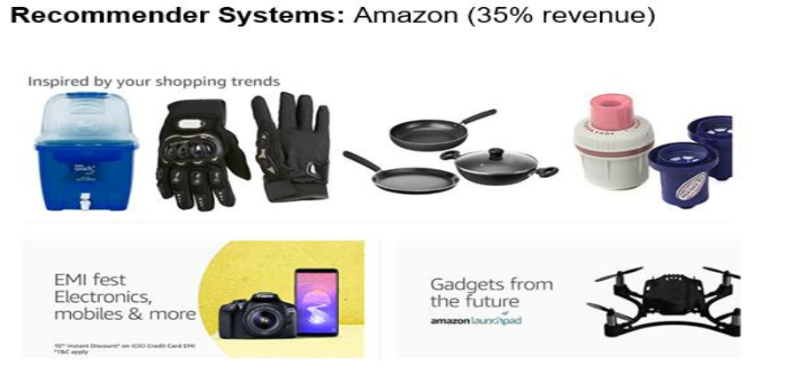
Applications/Examples
BITS Pilani, Pilani Campus

Slide 9
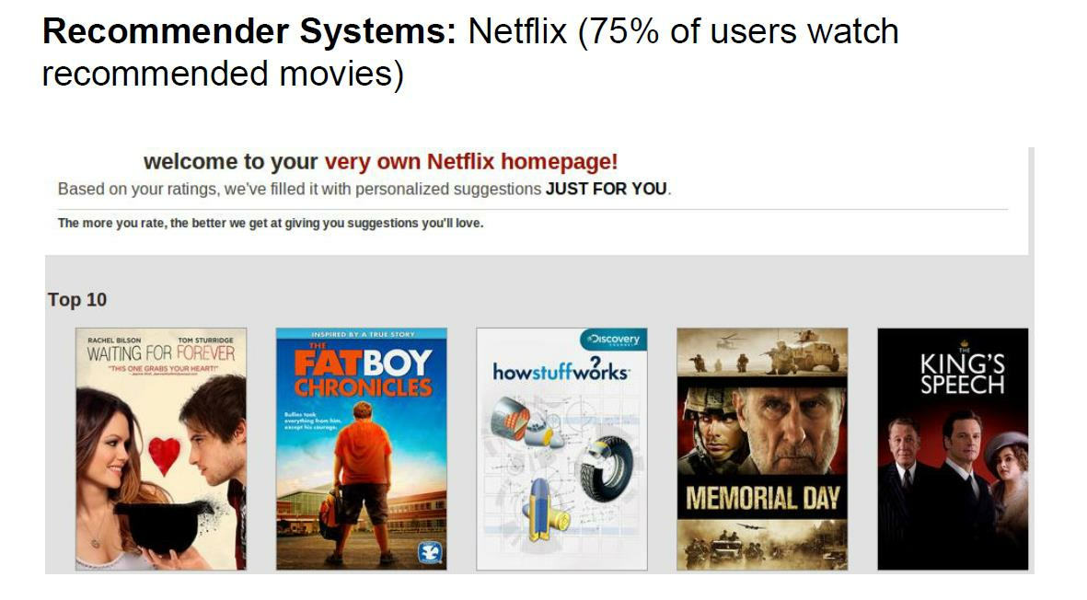
Applications/Examples
BITS Pilani, Pilani Campus

Slide 10
Applications/Examples
BITS Pilani, Pilani Campus

Slide 11
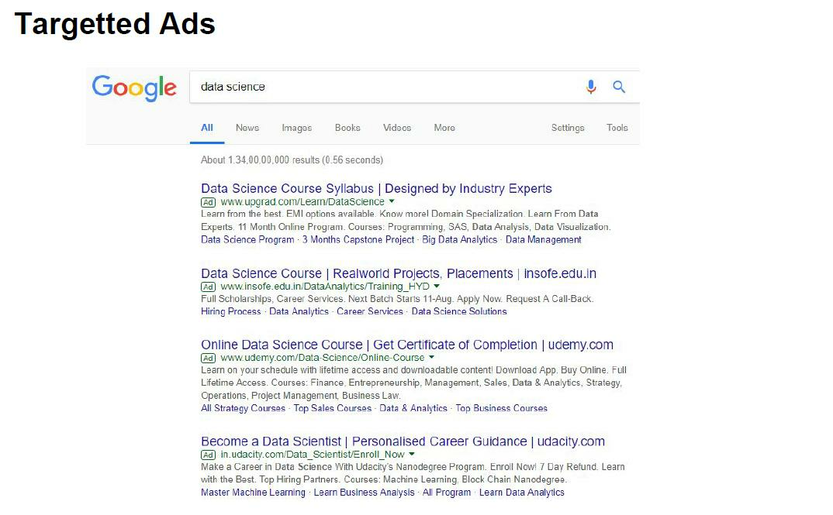
Applications/Examples
BITS Pilani, Pilani Campus

Slide 12
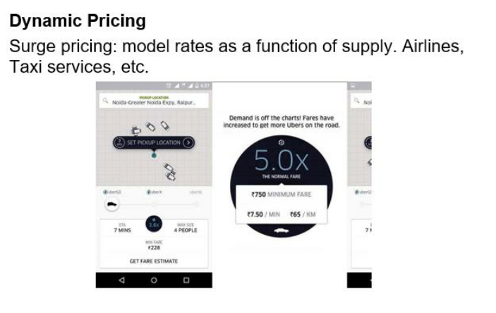
Applications/Examples
BITS Pilani, Pilani Campus

Slide 13
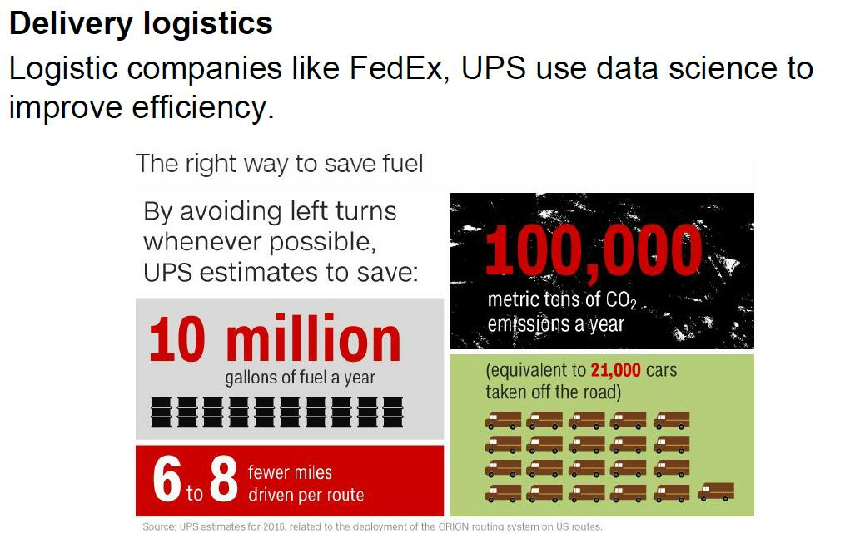
Applications/Examples
Traveler's Salesman Problem (TSP),
Vehicle routing Problem (VRP),
BITS Pilani, Pilani Campus

Slide 14
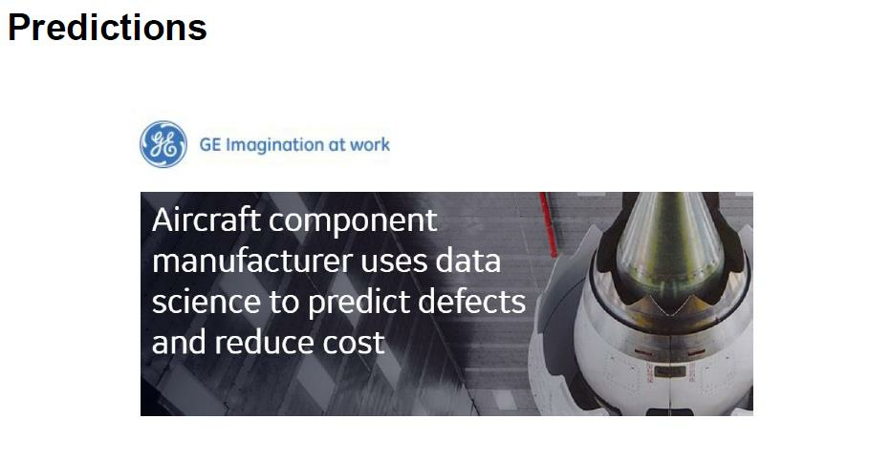
Applications/Examples
Smart Grids in IoT Network predict shelf-life of Transformers
Smart meters in IOT Network predict shelf life of meters
Prediction of HW faults in network
BITS Pilani, Pilani Campus

Slide 15

Applications/Examples
Loan Frauds/defaults
Credit Card frauds/defaults
Insurance Premium Prediction
Banking fraud detection
BITS Pilani, Pilani Campus

Slide 16

Applications/Examples
Preventive maintenance
Prediction of faults in network
Geo-location wise workforce management for fault support
Prediction of preventive maintenance life-cycle for network devices
Field Support Org cost reduction by improving First Time Right (FTR), reducing Site visits
BITS Pilani, Pilani Campus

Slide 17

Applications/Examples
Google maps
Free community using Google APIs for Geo-location, distance APIs etc. – source of data for Google maps
BITS Pilani, Pilani Campus

Slide 18
Common Applications of Data Science
Fraud & Risk Detection
Healthcare – Medical image analysis, genetics & genomics, drug development etc.
Internet Search – Knowledge Graphs (Semantic Networks) based on Resource Descriptive Framework RDF
Targeted Advertising – Facebook friends referral ads, Amazon past purchase based products ads, Google search based ads
Image Recognition – unlocking phone based on face; App which identifies object you point to; identifying celebrities in pictures; Invoice processing etc.
Speech recognition – voice recorders, human speech conversations Bots – ok google !!
Airline routing – Auto-pilot
Natural Language processing- document translation , chat bots
Augmented Reality – VR games, simulators/ training centers etc.

Slide 19
Motivational Examples of Data Science and AI
New AI Algorithm Can Now Guess What You Look Like Based Just On Your Voice https://www.analyticsindiamag.com/new-ai-algorithm-can-now-guess-what-you-look-like-based-just-on-your-voice/
How Machine Learning Can Eliminate The Emotional Aspect Of Investing Money https://www.analyticsindiamag.com/how-machine-learning-can-eliminate-the-emotional-aspect-of-investing-money/
How artificial intelligence changed the face of banking in India https://yourstory.com/2019/05/how-artificial-intelligence-changed-banking-sector
Machine Learning may help capture fusion energy on Earth https://odishatv.in/science/machine-learning-may-help-capture-fusion-energy-on-earth-371697
How artificial intelligence can slowly change the healthcare landscape https://yourstory.com/2019/05/how-artificial-intelligence-change-the-healthcare
Googles AI system better than humans at spotting lung cancer: Study https://www.business-standard.com/article/pti-stories/google-s-ai-system-better-than-humans-at-spotting-lung-cancer-study-119052100509_1.html
Machine learning overtakes humans in predicting death or heart attack https://medicalxpress.com/news/2019-05-machine-humans-death-heart.html
Machine learning could predict death or heart attack with over 90% accuracy: Study https://www.timesnownews.com/health/article/machine-learning-could-predict-death-or-heart-attack-with-over-90-accuracy-study/417593
Why machine learning could be the key to the future of gambling https://www.techradar.com/news/why-machine-learning-could-be-the-key-to-the-future-of-gambling

Slide 20
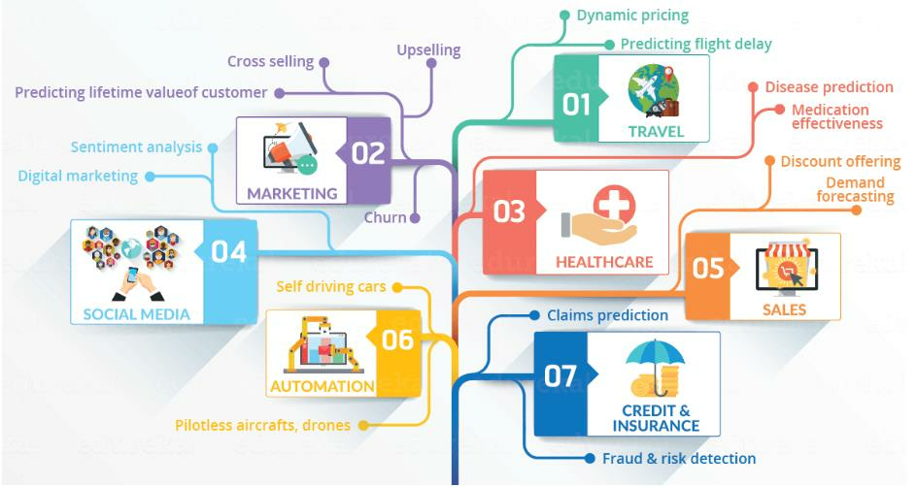
Data Science in Various Domains
14
BITS Pilani, Pilani Campus

Slide 21
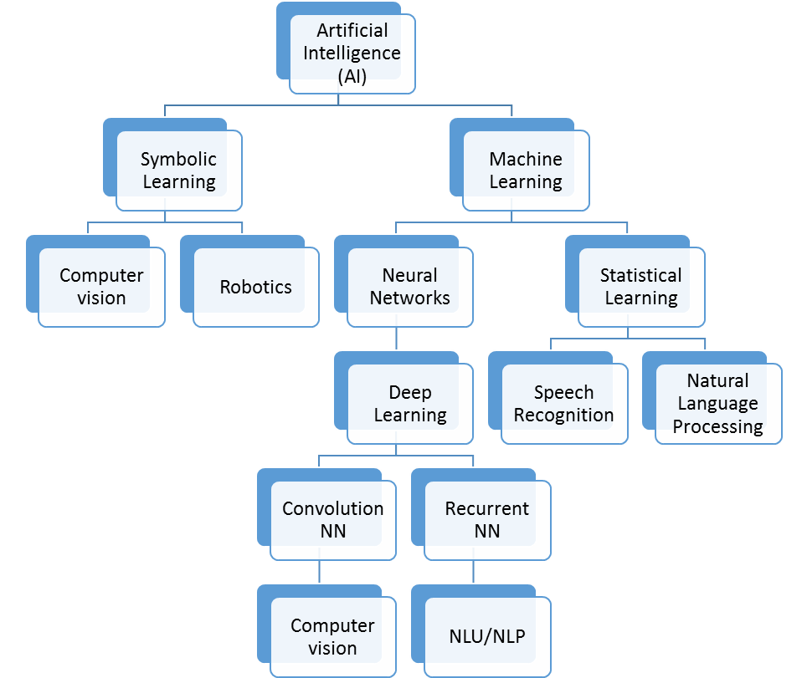
Evolution of Data Science to Artificial Intelligence
Machine Learning
Deep Learning
Artificial Intelligence
Data
Science

Slide 22
Machine Learning vs Data Science?
Machine
learning
and
statistics
both
are
part
of
data
science.
The
word learning in machine learning means that the algorithms depend on some
data, used as a training set, to fine-tune some model or algorithm parameters.
This encompasses many techniques such as regression, naive Bayes or
supervised clustering. But not all techniques fit in this category.
For instance, unsupervised clustering - a statistical and data science technique -
aims at detecting clusters and cluster structures without any a-priori knowledge or
training set to help the classification algorithm. A human being is needed to label
the clusters found. Some techniques are hybrid, such as semi-supervised
classification. Some pattern detection or density estimation techniques fit in this
category.
BITS Pilani, Pilani Campus

Slide 23
Machine Learning vs Data Science?
Data science is much more than machine learning though. Data, in data science,
may or may not come from a machine or mechanical process (survey data could
be manually collected, clinical trials involve a specific type of small data) and it
might have nothing to do with learning as I have just discussed. But the main
difference is the fact that data science covers the whole spectrum of data
processing, not just the algorithmic or statistical aspects. In particular, data
science also covers
•
data integration
•
distributed architecture
•
automating machine learning
•
data visualization
•
dashboards and BI
•
data engineering
•
deployment in production mode
•
automated, data-driven decisions
BITS Pilani, Pilani Campus

Slide 24
Data Science Vs. Statistics
The fields differ in their modeling processes, the size of their data, the types of problems studied, the background of the people in the field, and the language used. However, the fields are closely related. Ultimately, both statistics and data science aim to extract knowledge from data.
Reference Links –
https://www.educba.com/data-science-vs-statistics/
https://www.displayr.com/statistics-vs-data-science-whats-the-difference/
https://link.springer.com/article/10.1007/s42081-018-0009-3

Slide 25
Data Science Vs. Statistics
Comparison | Data Science | Statistics
1# Meaning | Data science is the business of learning from data, which is traditionally the business of statistics. Data science, is often understood as a broader, task-driven and computationally-oriented version of statistics; which is an inter-disciplinary area of scientific techniques. | Statistics is a mathematics branch, which also aims to provide methods for data representation, analysis & further evaluations.
2# Concept of models | Modelling process in data science is done by comparing the predictive accuracy of different machine learning methods, choosing the model which is most accurate. While data science focuses on comparing many methods to create the best machine learning model, statistics instead improves a single, simple model to best suit the data. | Statisticians take a different approach to building and testing their models. The starting point in statistics is usually a simple model (e.g., linear regression), and the data is checked to see if it consistent with the assumptions of that model. The model is improved by addressing any assumptions in the model that are violated.
3# Big Data | Data scientists often deal with huge databases - so big that they cannot be stored on a single computer. | Historically, the focus on statistics has been much more about what can be learned from very small quantities of data.
4# Types of problems | Data science problems often relate to making predictions and optimizing search of large databases. The end-goal of data science analysis is more often to do with a specific database or predictive model. | In contrast, the problems studied by statistics are more often focused on drawing conclusions about the world at large. The end-goal of statistical analysis is often to draw a conclusion about what causes what, based on the quantification of uncertainty.
5# Skillset & Language | Data scientists tend to come from engineering backgrounds. Language used – Machine learning, Feature engineering, Supervised learning, Labeling, one-hot coding | Statisticians are usually trained by math departments. Language used- Estimating, Classification, Covariate/predictor/independent variable; Response/output/dependent variable; dummy variable/indicator coding

Slide 26
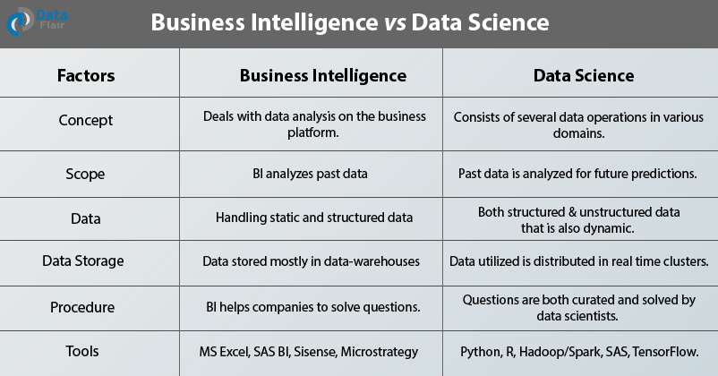
Data Science Vs. Business Intelligence (BI)

Slide 27
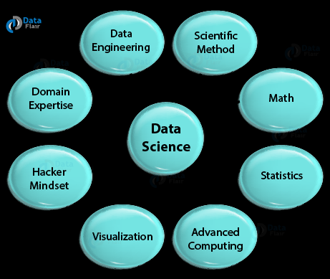
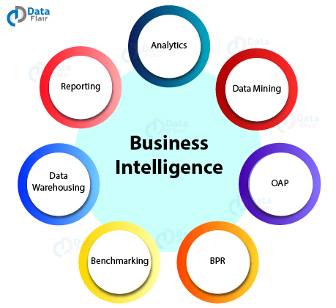
Data Science Vs. Business Intelligence (BI)
DATA SCIENCE
BUSINESS INTELLIGENCE

Slide 28
Data Science Vs. BI
References –
https://www.dataversity.net/data-science-vs-business-intelligence/#
https://towardsdatascience.com/data-science-vs-business-intelligence-same-but-completely-different-1d5900c9cc95
https://data-flair.training/blogs/business-intelligence-vs-data-science/
https://analyticsindiamag.com/business-intelligence-different-data-science/

Slide 29
Roles of Data Scientist
Key role of Data scientist is to define the data architecture i.e. rules, policies or standard that govern which data is collected, stored, arranged, integrated, and put to use in data systems.
Data Collection techniques – Interviews, Questionnaire/surveys, Observations/Transactions, Documents/records, Case studies
Data Management – DBMS -> Relational DBMS, NoSQL ( In memory, Columnar, key-value based, document based etc.)
Data Preparation – cleaning, organizing, combining, pruning, missing value handling, labelling data for visualizing data and applying machine learning
Data Analytics – Stream involves automating insights into certain data set, visualizing the results, uses queries & data aggregation procedures
Notes:
Difference between data vs information ? e.g. marks of students in a class is raw data; average score of class, top 5 percentile etc. is information
Data Preparation – R (readr, readcsv); Python (pandas, numpy) – ask for examples from audience, FSO data example

Slide 30
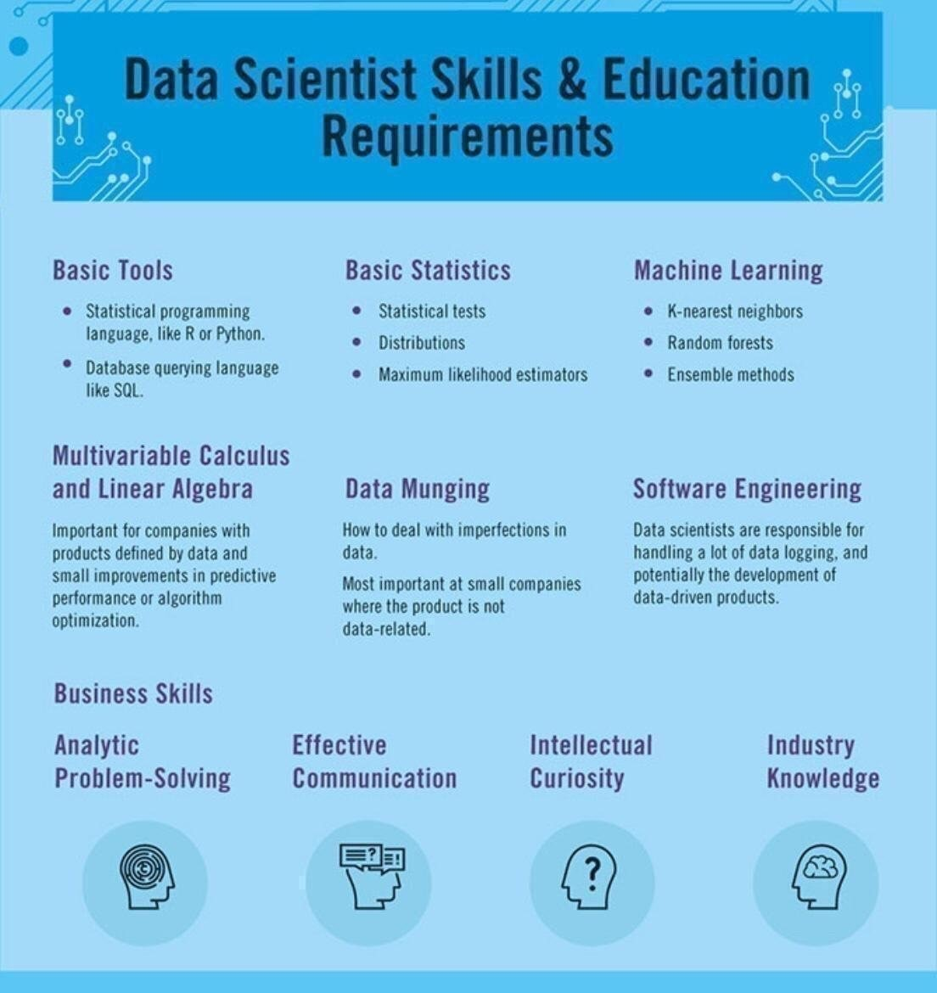
Skills Required – Data Scientist

Slide 31
Software Engineering for Data Science 1/
For data scientists, software is the generalization of a specific aspect of a data analysis. Software allows for the systematizing and the standardizing of a procedure, so that different people can use it and understand what it's doing, at any given time.
So if specific parts of a data analysis may require implementing or applying a number of procedures or tools together.
Software is the encompassing of all these tools into a specific module or procedure that can be repeatedly applied in a variety of settings
Software formalizes and abstracts the functionality of a set of procedures or tools, by developing a well defined interface to the analysis. So the software will have an interface, or a set of inputs and a set of outputs that are well understood.
So for example, most statistical packages will have a linear regression, a function which has a very well defined interface
There are basically three kind of levels of software –
1st level - Code that is encapsulating automation of a set of procedures. For example, a loop of some sort, never repeats an operation multiple times.
2nd level- Writing a function - which is used to encapsulate a set of instructions. And the key thing about a function is that you'll have to define some sort of interface, which will be the inputs to the function. And then the function may have a set of outputs or it may have some side effect for example, if it's a plotting function. Data Cleaning function, Missing Value handler etc.
Highest level is the actual software package - Which will often be a collection of functions or functions in other things. That will be a little bit more formal because there'll be a very specific interface or API that a user has to understand. And often for a software package there'll be a level of convenience features for users, like documentation, or examples, or tutorials that may come with it, to help the user, to kind of apply the software to many different settings
References –
https://towardsdatascience.com/data-science-is-becoming-software-engineering-53e31314939a
https://www.coursera.org/lecture/data-science-course/what-is-software-engineering-for-data-science-cmnBH
https://careerkarma.com/blog/data-science-vs-software-engineering/
Notes:
For data scientists, software is the generalization of a specific aspect of a data analysis. So if specific parts of a data analysis may require implementing or applying a number of procedures or tools together. Software is the encompassing of all these tools into a specific module or procedure that can be repeatedly applied in a variety of settings. So software allows for the systematizing and the standardizing of a procedure, so that different people can use it and understand what it's gonna do, at any given time. What software is useful for, is that it formalizes and abstracts the functionality of a set of procedures or tools, by developing a well defined interface to the analysis. So the software will have an interface, or a set of inputs and a set of outputs that are well understood.
So for example, most statistical packages will have a linear regression, a function which has a very well defined interface, usually. For example, you'll have to input things like the outcome and the set of predictors, and maybe there will be some other inputs like the data set or weights. But most linear regression functions kind of work in that way. And importantly the user does not have to know exactly how the linear regression calculation is done underneath the hood. Rather, they only need to know that they need to specify the outcome, the predictors, and a couple of other things. And so the linear regression function abstracts all the details that go on underneath, that are required to implement linear regression, so that the user can apply the tool in a variety of settings.
So there are basically three kind of levels of software that I can think about, going from kind of the simplest to the most abstract. And so at the first level you might just have some code that you wrote, and so this is really the first step towards encapsulating automation of a set of procedures. For example, you might have a loop of some sort, never repeats an operation multiple times. So this is the first tip. And then the next step might be some sort of function. So regardless of what language you may be using, often there will be some notion of a function, which is used to encapsulate a set of instructions. And the key thing about a function is that you'll have to define some sort of interface, which will be the inputs to the function. And then the function may have a set of outputs or it may have some side effect for example, if it's a plotting function. And then, so the user only needs to know those inputs and kind of what the outputs will be. And so this is kind of the first level of abstraction that you might encounter, where you have to actually define and interface to that function. And then the very highest level is the actual software package. Which will often be a collection of functions or functions in other things. That will be a little bit more formal because there'll be a very specific interface or API that a user has to understand. And often for a software package there'll be a level of convenience features for users, like documentation, or examples, or tutorials that may come with it, to help the user, to kind of apply the software to many different settings. So a full on software package will be most general in the sense that it should be applicable to kind of more than one setting. And maybe become more broadly useful to people. So, one question that you'll find yourself asking, is at what point do you need to systematize common tasks and procedures across projects versus, you know, recreating code or writing new code from scratch on every new project? Now it depends on a variety of factors and answering this question may require communication within your team, and with people outside of your team potentially. Because you may need to have an understanding of how often a given process is repeated, or how often a given type of data analysis is done, in order to weigh the costs and the benefits of kind of investing in either a software package or something like that. And so within your team, you may want to ask yourself, is the data analysis you're gonna do, is that something you're gonna build upon for future work, or is it just gonna be a one shot deal. Now in my experience, there are relatively few one shot deals out there. Often you will have to do a certain analysis or a certain type of analysis more than once, twice, or even three times. And at that point, it's usually often, you've kind of reached the threshold where you wanna write some code, write some software, or at least a function. So the point at which you need to systematize a given set of procedures, is probably gonna be sooner than you think it is. Because things will more likely be done more than once. Now the initial investment for developing more formal software will be higher, of course, but that will likely pay off in savings in time down the road. So my basic rule of thumb is that, if you're gonna do something once, that does happen on occasion, just write some code and document it very well. The important thing is that you wanna make sure that you understand what the code does, and so that requires both writing the code well and writing documentation. Cuz you wanna be able to reproduce it down the road, in case you ever come back to it, or in case someone else comes back to it, and needs to understand what was done. If you're gonna do something twice, write a function. This allows you to abstract a small piece of code, it forces you to define an interface, so you have well defined inputs and outputs. And that will allow for other people to access a given function and apply it to whatever situation they're in. And then if you're gonna do something three times or more, you should think about writing a small package. It doesn't have to be commercial level software. But a small package which encapsulates the set of operations that you're gonna be doing in a given analysis. And also write some real documentation so that people can understand what's supposed to be going on, and can apply the software to a different situation if they have to.
Explore our Catalog
Join for free and get personalized recommendations, updates and offers.
Get Started
Coursera

Slide 32
Software Engineering for Data Science 2/
Software Engineering was historically considered a different highly technical field as compared to Data Science, and while both have similar skill sets, there are big differences in the ways in which these skills are usually applied.
Differ in Methodologies – SDLC, Data Science Project Process (will study in session 2/3)
Differ in Objectives - Data science tends to be much more about analysis of data in practice to solve a business objective, with some aspects of programming and development thrown in. Software engineering, on the other hand, tends to focus on creating systems and software that is user-friendly and that serves a specific purpose.
Differ in Approaches - Data science is a very process-oriented field. Its practitioners ingest and analyze data sets in order to better understand a problem and arrive at a solution. Software engineering, on the other hand, is more likely to approach tasks with existing frameworks and methodologies.
Differ in Tools - A data scientist’s wheelhouse contains tools for data analytics, data visualization, working with databases, machine learning, and predictive modeling. using Amazon S3, MongoDB, Hadoop, MySQL, Postgresql, or something similar. For model building, there’s a good chance they’ll be working with Statsmodels or Scikit-learn. Distributed processing of big data requires Apache Spark. A software engineer utilizes tools for software design and analysis, software testing, programming languages, web application tools, and much more.

Slide 33
Software Engineering for Data Science 3/
Data science is becoming software engineering
In data science over the last few years, perhaps the most significant and hardest to ignore has been the increased focus on deployment and productionization of models.
The skill sets of software engineers and data scientists are converging, at least when it comes to product-facing data science applications, like building recommender systems. Data scientists are being asked to take care of deployment and productionization, and software engineers are being asked to expand their skill set to include modeling.
Historically, data science and software engineering weren’t nearly as closely integrated as they are today.
Feature Engineering which was manually done in machine learning approaches by data scientists; that is being automatically done by Deep Learning models coded in SWs (Tensorflow, Pytorch libraries)
One aspect of data science that’s often over-emphasized is model tuning. It’s very rare that your focus as a data scientist will be on making a model 1% better; typically it’s much more important to get a “good enough” model out the door and in front of users, which is why software engineering and deployment skills are increasingly growing in importance over model tuning.
2 Types of Data Science Projects
Building Data science process libraries, models, frameworks, creating algorithms
Building Services & products that use Data science libraries& solve a business problem

Slide 34
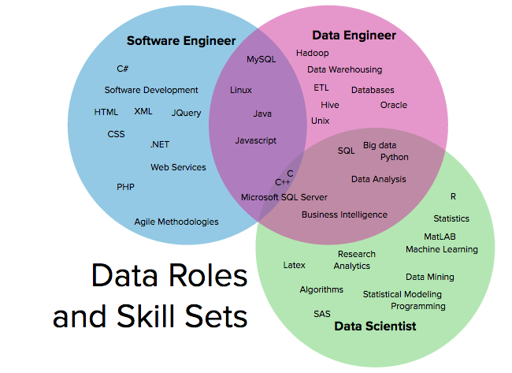
Skills Venn diagram

Slide 35
Data Scientist Toolbox
Programming Languages -R, Python, SQL, Matlab
Data Science Libraries/ frameworks – Tensorflow, Pytorch, Scikit-learn, plotlib
Data Handling Tools – RDBMS ( MYSQL, PostGres, Microsoft SQL Server, Oracle DB), NOSQL DB(MongoDB, Cassandra, HBASE), Big Data Technologies (HADOOP, SPARK, HIVE)
Analytics Modelling Tools – SAS, SPSS, Cloud-Based AI/ML Interfaces (AWS, GCP, Azure)
Reference
https://www.coursera.org/learn/data-scientists-tools

Slide 36
Ethics for Data Science
Ethics for different stages in Data Science projects –
Project Selection & Scoping - Is data science the right tool for the job/problem being solved?
Pursuing a data science project can mean pulling resources away from other initiatives that could have a greater impact. It’s important to recognize when this is not the case and resources are better directed elsewhere.
Building the Team - Does the team include and/or consider individuals and institutions who will ultimately be affected by the tool?
They should engage members of their target communities along with data scientists
Data Collection
Does collecting data impede on anyone’s privacy?
Were the systems and processes used to collect the data biased against any groups?
Data analytics
What bias is the team introducing? (dependent variable selection)
Should the team include features that could be discriminatory? Features such as race, gender, or income
Is the analysis sufficiently transparent? Machine learning models can be opaque, particularly around what variables are driving predictions
Implementation
Are the people using models aware of its shortcomings?
What are the consequences of not acting on false negatives (and acting on false positives)?
Notes:
Facebook controversial emotion experiment
Tay was an artificial intelligence chatter bot that was originally released by Microsoft Corporation via Twitter on March 23, 2016; it caused subsequent controversy when the bot began to post inflammatory and offensive tweets through its Twitter account, forcing Microsoft to shut down the service only 16 hours after its launch

Slide 37
Data Science Challenges/ Concerns
Identifying the problem
One of the major steps in analyzing a problem and designing a solution is to first figure out the problem properly and define each aspect of it. Many times Data scientists opt for a mechanical approach and start working on data sets and tools without a clear definition of the business problem or the client requirement.
Access to right data – Data quantity
For right analysis, it is very important to lay the hands on the right kind of data. Gaining access to a variety of data in the most appropriate format is quite difficult as well as time-consuming. There could be issues ranging from hidden data, insufficient volume of data or less variety in the kind of data. Data could be spread unevenly across various lines of business so getting permission to access that data can also pose a challenge.
Data Cleansing – Data quality
According to a study by MIT, Big Data has begun to cost companies up to 25% of possible revenue because cleansing bad data is eroding operating expenses.
Lack of domain expertise
Data Scientists also need to have sound domain knowledge and gain subject matter expertise. One of the biggest challenges faced by data scientists is to apply domain knowledge to business solutions. Data scientists are a bridge between the IT department and the top management.
Data security issues
Since data is extracted through a lot of interconnected channels, social media as well as other nodes, there is increased vulnerability of hacker attacks. Due to the confidentiality element of data, Data scientists are facing obstacles in data extraction, usage, building models or algorithms. The process of obtaining consent from users is causing a major delay in turnaround time and cost overruns.

Slide 38
References
Data collection
https://www.slideshare.net/priyansakthi/methods-of-data-collection-16037781;
https://research-methodology.net/research-methods/quantitative-research/;
https://cyfar.org/data-collection-techniques
Data Management
https://searchsqlserver.techtarget.com/definition/database-management-system
https://www.stoodnt.com/blog/data-engineer-vs-data-scientist/
https://www.dataspace.com/big-data-strategy/so-what-is-the-difference-between-a-programmer-and-a-data-scientist/
Data Preparation
https://searchbusinessanalytics.techtarget.com/definition/data-preparation
https://www.dataquest.io/blog/python-vs-r/
https://www.kdnuggets.com/2017/06/7-steps-mastering-data-preparation-python.html
Data Analytics
https://www.simplilearn.com/data-science-vs-big-data-vs-data-analytics-article
https://searchdatamanagement.techtarget.com/definition/data-analytics
Data analytics Ethics
https://www.coursera.org/learn/data-science-ethics
https://dssg.uchicago.edu/2015/09/18/an-ethical-checklist-for-data-science/
Data analytics Challenges/ Concerns
https://www.forbes.com/sites/laurencebradford/2018/09/06/8-real-challenges-data-scientists-face/#7105dced6d99
https://www.proschoolonline.com/blog/challenges-faced-by-data-scientists
https://www.analyticsinsight.net/what-are-the-major-challenges-faced-by-data-scientists/

Slide 39
Appendix
Additional Slides

Slide 40
Network Function Virtualization: Background

Slide 41
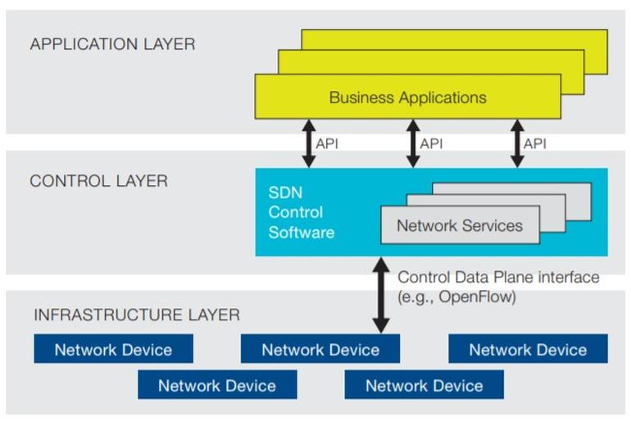
SDN Architecture / Layers
Image Source: Open Networking Foundation

Slide 42
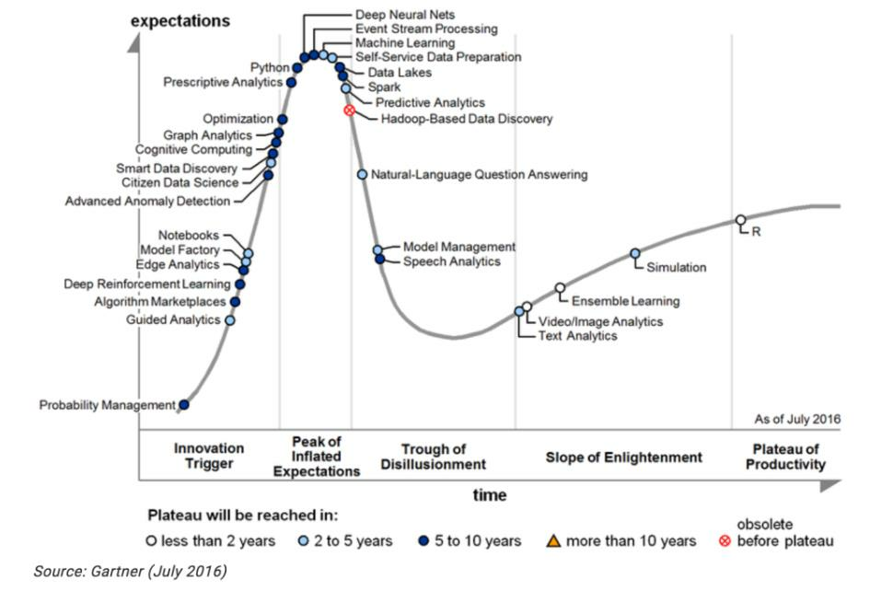
Era of Data Science
BITS Pilani, Pilani Campus

